Slide 1
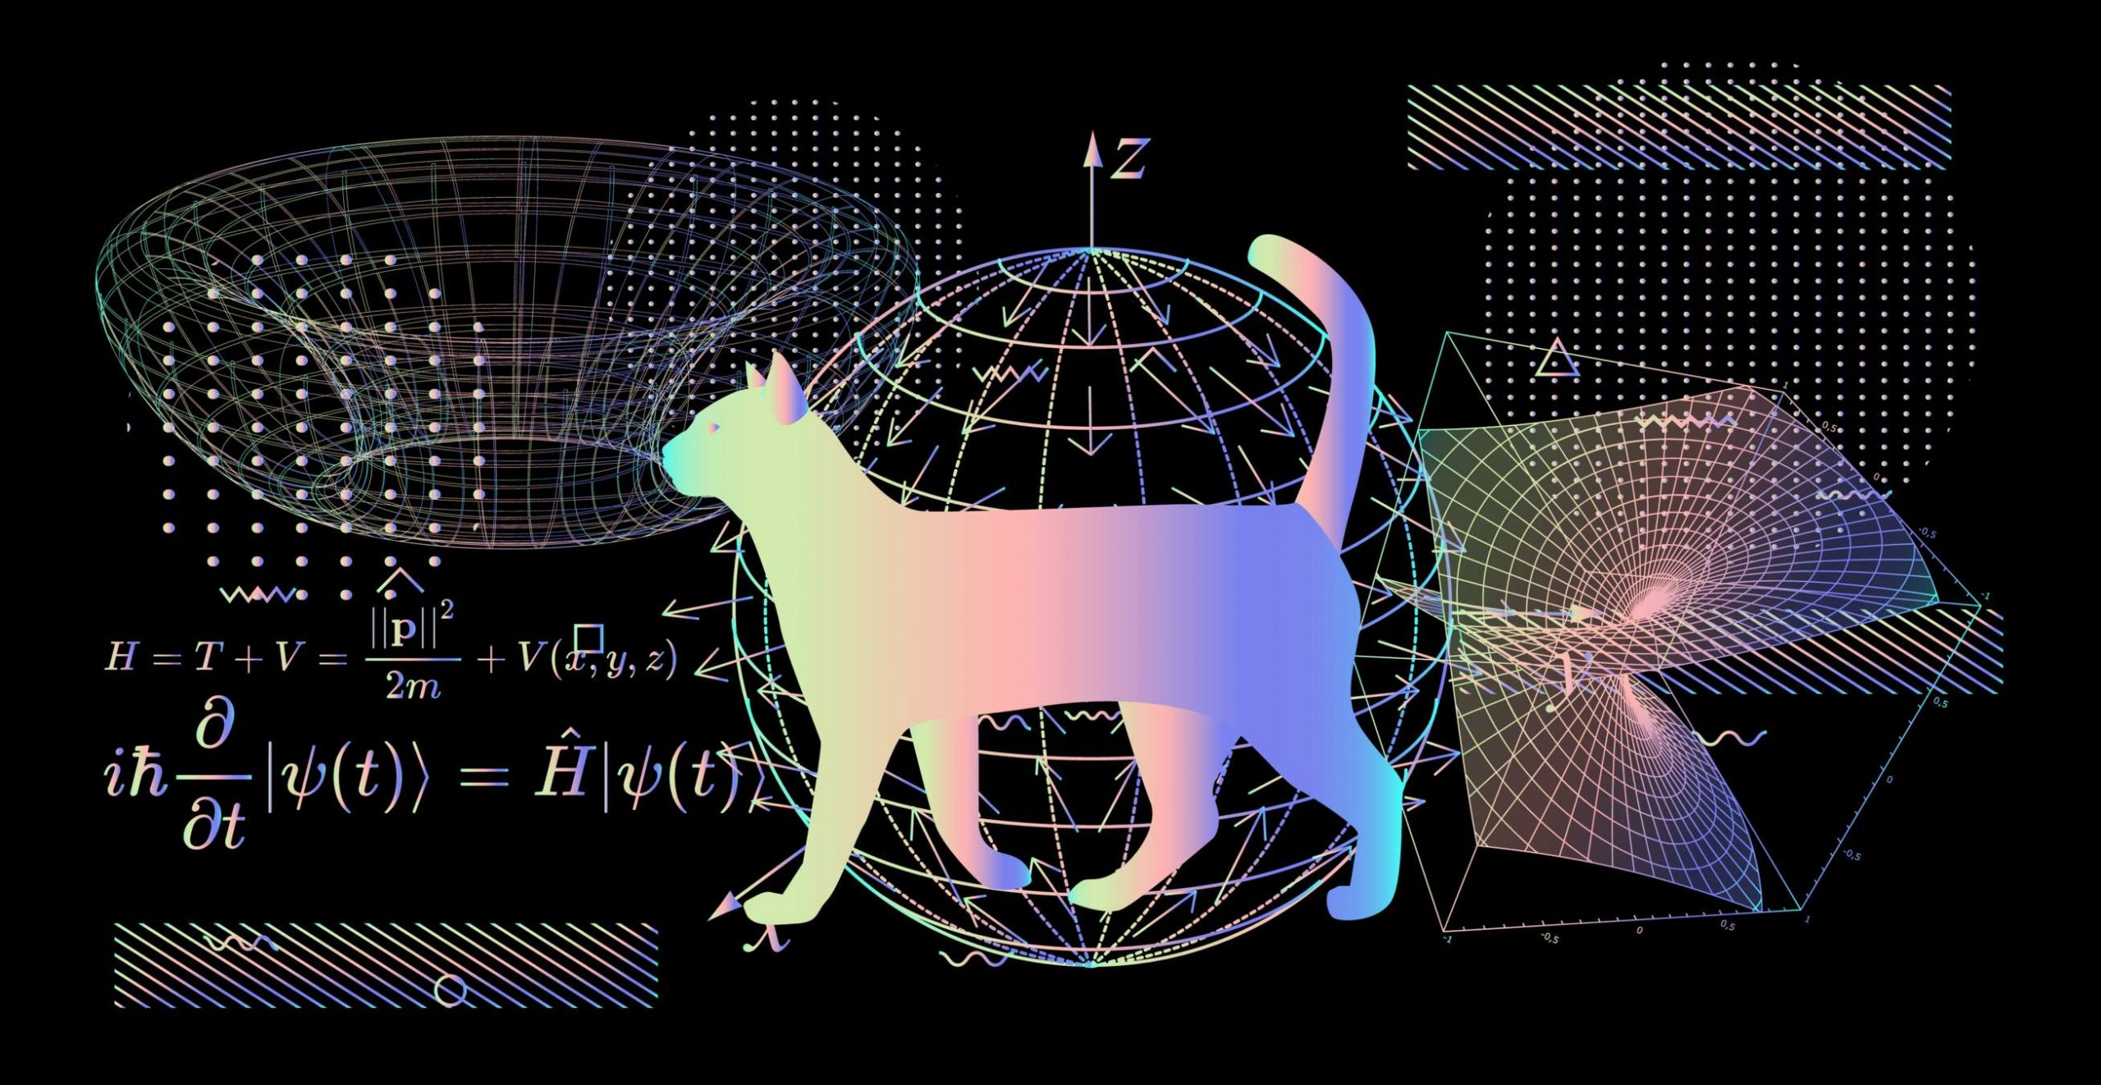
Introduction to Quantum Computing

Slide 2
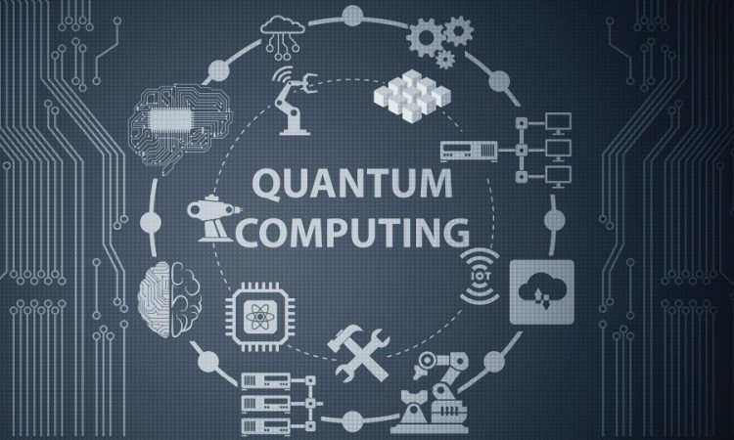
What is quantum computing (QC)?
Quantum computing is a new paradigm of algorithmic study which extends quantum mechanical phenomena to traditional or classical computing

Slide 3
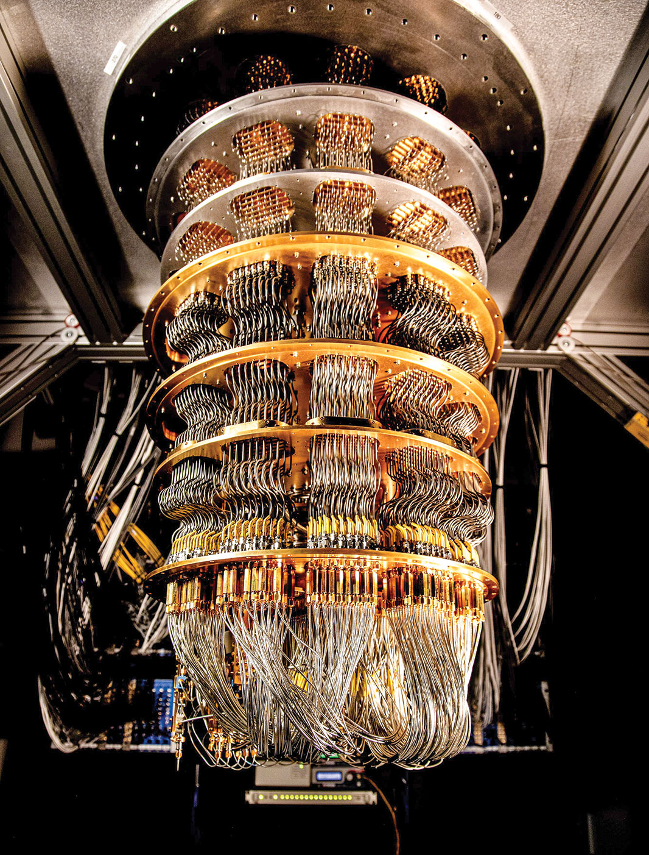
What is a quantum computer?
A quantum computer is a device that performs computation by using the properties described by quantum mechanics
Source: science.org

Slide 4
Why quantum computing?
Classical computational power does not scale exponentially
To double the computation power of a CPU, the number of transistors has to be approximately doubled
Most problems that apply to the physical world are exponential
Exponential problems are not practically solvable using current classical computers

Slide 5
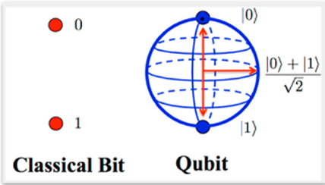
Qubits
A qubit (or quantum bit) is the fundamental unit of quantum information
Qubits can exist in multiple states simultaneously
This can be leveraged to process more information in parallel as compared to classical bits (only 1 or 0)
For instance, a single qubit can represent two states at the same time in what is known as superposition
Source: OpenMind

Slide 6
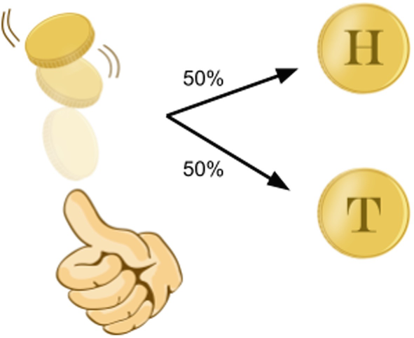
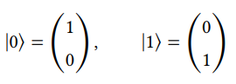
Superposition
Quantum property which allows qubits to exist in multiple states at the same time
All possible values for the state of a single qubit live in a complex vector space of dimension 2
Example of possible states:

Slide 7
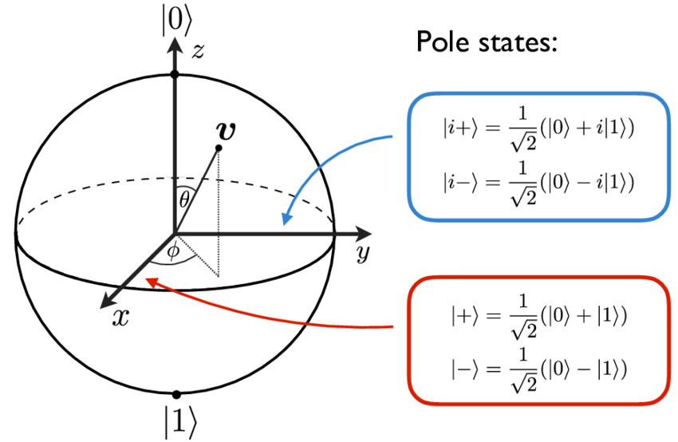
Bloch Sphere
Geometrical representation of all possible states of a qubit
Helps understand the data given by a superposition
|0> and |1> form the computational basis
North and South poles of the sphere
Source: Research Gate

Slide 8
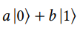
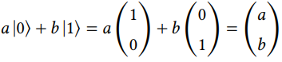
Notation: Single Qubit
Dirac notation: a single qubit can be in state |1> or |0> which are vectors of dimension 2 (each vector has exactly two entries)
A single qubit in superposition is generally represented as
a and b are known as the amplitudes, and can be complex numbers
Putting all of this together we obtain the following:

Slide 9
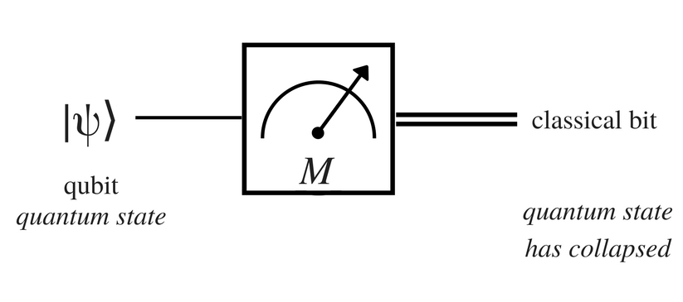

Measurement
Assume we have the single qubit case
Thus, in order to determine its state we must perform a measurement which will produce either 1 or 0
Once a measurement occurs, superposition is destroyed which is said to have collapsed to a state
The result of the measured state is probabilistic
Probability of 0:${\left|a\right|}^{2}$
Probability of 1: ${\left|b\right|}^{2}$

Slide 10
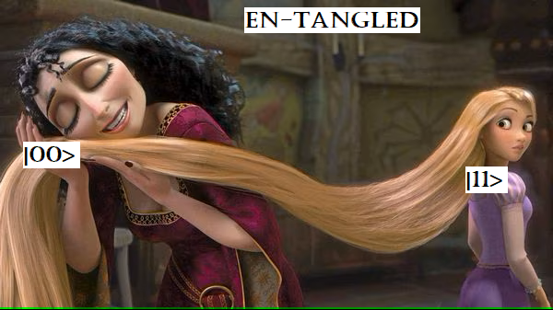
Entanglement
A quantum phenomenon where two or more qubits become correlated
The state of one qubit is dependent on the state of the other(s)
Powerful notion in quantum computing
Allows for enriched computing and communication protocols
Visual example of a Bell State

Slide 11
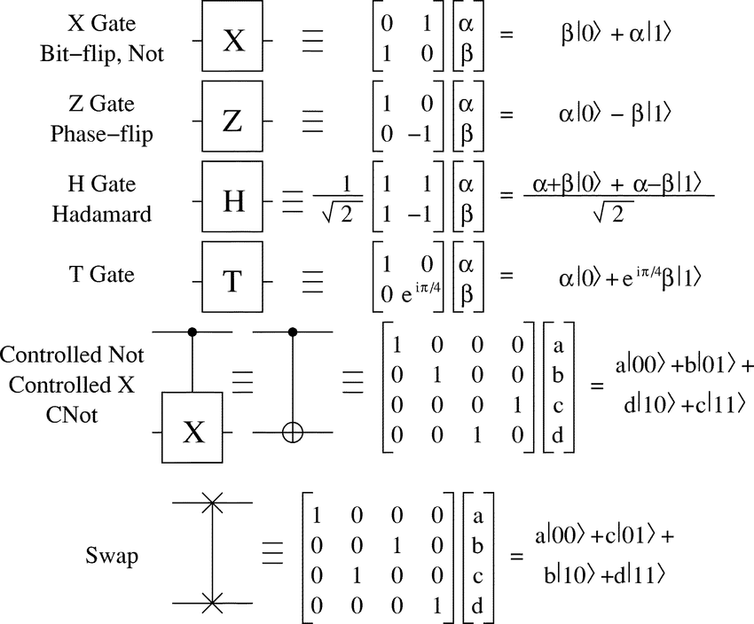
Quantum Gates
Similar to classical logic cates
Operations applied to qubits to manipulate and transform their states
Represented as a Unitary Matrix
Examples:
Flipping the state
Rotation (modification of probability of each state)
Hadamard (H) Gate: creates superposition
Source: Research Gate

Slide 12
Quantum Algorithms
Algorithms specifically designed to leverage the quantum properties of qubits
Typically implemented as a quantum circuit which is a sequence of quantum gates
Examples:
Shor’s Algorithm: prime number factorization, used for cybersecurity
Grover’s Algorithm: searching a sorted or unsorted database, such as a phonebook
Goal: convert exponential time classical algorithms to polynomial time quantum algorithms for considerable speedup

Slide 13
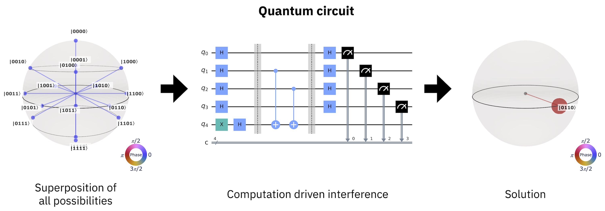
General Quantum Algorithm
Source: Qiskit

Slide 14
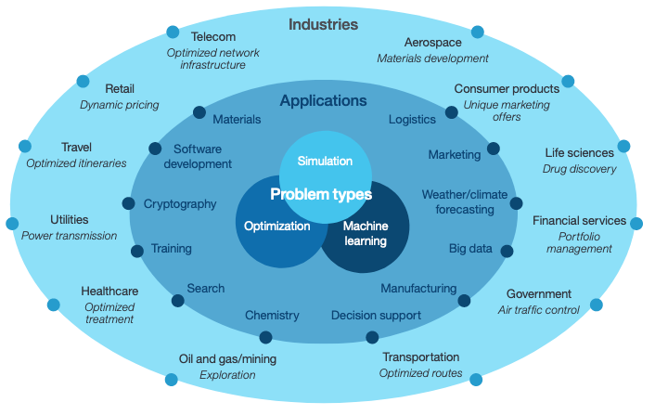
Common Applications of QC
Cryptography
Optimization
Simulations
Machine learning
Source: IBM

